Slide 1
4th International Consumer Brand Relationships Conference
Exploring Consumer- Brand Relationships: synthesizing behavioural branding, brand love and brand co-creation
Hans Ruediger Kaufmann, Agapi Manarioti

Slide 2
How consumers relate to brands?
Through a process involving meaning seeking, self- expression, emotions and social, intrinsic rewards.
Schmitt, 2012
Kaufmann et al, 2012
Hans Ruediger Kaufmann, Agapi Manarioti
Notes:
Schmitt, 2012: Three layers of engagement, from object oriented to social engagement.
Kaufmann et al 2012, from browser to committed active member

Slide 3
The brand as social construct: The role of Co-creation
An ongoing marketing dialogue among all stakeholders demonstrated as active participation in a brand community.
Significantly enabled by the expansion of the social media
Consumers-members of the brand community:
Act as brand missionaries/ ambassadors, attracting and introducing new members to the community
Willingly accept new products or brand extensions, they might even participate in their development
Support and defend the brand in times of crisis
Hans Ruediger Kaufmann, Agapi Manarioti

Slide 4
The brand as social construct: The role of Co-creation (2)
From the literature review on co-creation:
Co-creation is the end state: a relationship based on emotions and value sharing precedes.
To become active member in the brand community the consumer must trust the brand and share a feeling of commitment to the community.
In this marketing dialogue, employees act as access points¹ and their behavior impacts the co-creating process.
¹: Hatch and Schultz, 2010
Hans Ruediger Kaufmann, Agapi Manarioti

Slide 5
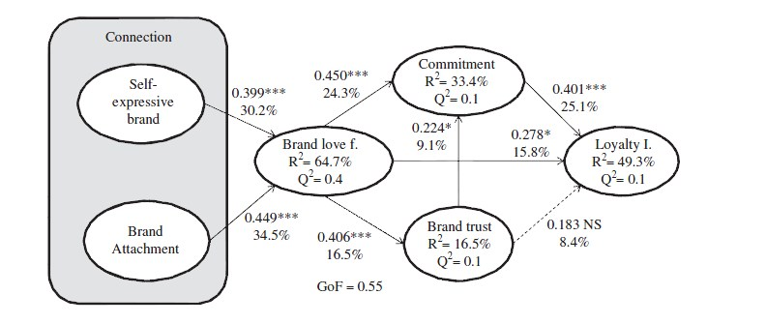
About loyalty and co-creation
No consensus, so far.
Loyalty is the outcome of the strong bonds in the brand community (Casaló, Flavián, Guinalíu, 2007; Muniz and O’Guinn, 2001; Algesheimer et al., 2005)
Co-creating behavior is the outcome of loyalty, a demonstration of extreme loyalty. (Kaufmann et al, 2012)
About brand love
Loureiro, Kaufmann, Vrontis, 2012
How can Brand Love Impact the Co-Creating Behaviour?
Is loyalty an antecedent or an outcome of Co-Creating Behaviour?
Hans Ruediger Kaufmann, Agapi Manarioti
Notes:
Those significant elements in the co-creation literature (expressiveness, emotions, commitment and trust) can be found in the brand love model presented here.

Slide 6
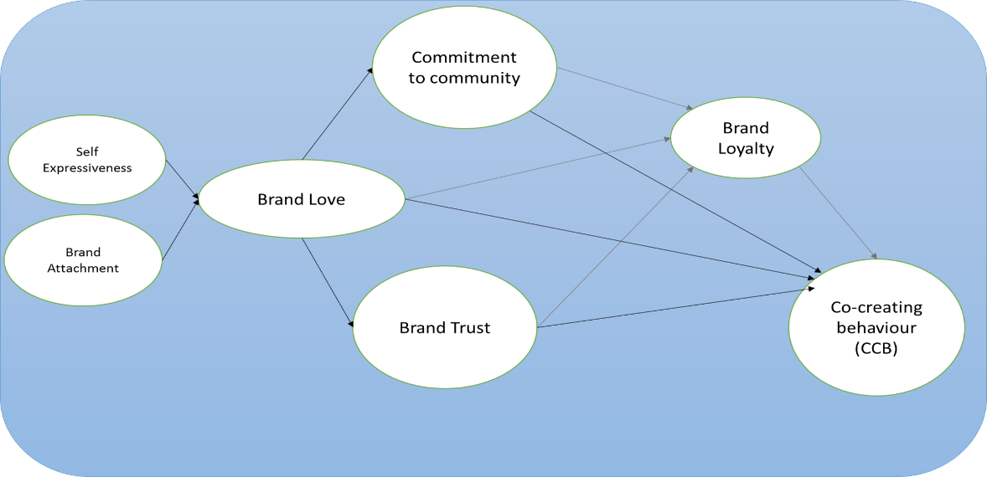
The initial model
Kaufmann, Manarioti, 2015
In this context, how is employee behavior related?
Hans Ruediger Kaufmann, Agapi Manarioti

Slide 7
About behavioural branding
Consumers connect easier to brands with distinctive human traits and employees acting in brand consistent manner humanize the brand, enabling the connection.
Can the brand building behaviour of the personnel impact the development of co-creating behaviour, directly or through the mediation of brand love?
When brands are humanized, consumption becomes a social act, providing the consumers with intrinsic rewards. The employee behavior can be perceived as the brand returning the love.
The employee behavior determines the quality of the brand experience, and ultimately the level of co-creation, through engagement and organizational self disclosure².
²: Hatch and Schultz, 2010
Hans Ruediger Kaufmann, Agapi Manarioti

Slide 8
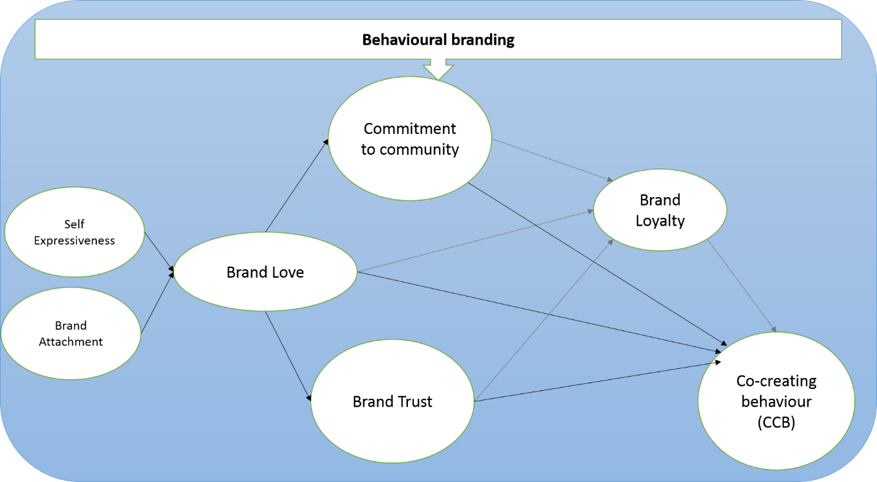
The proposed model
Kaufmann, Manarioti, 2015
Hans Ruediger Kaufmann, Agapi Manarioti

Slide 9
Further research and managerial implications
The model will be validated through qualitative and quantitative research, that will be undertaken in Cyprus, focused on the hedonic industry of cosmetics.
Later, it must be also tested to different industries and cultures and also to online contexts with no geographical boundaries.
The integration of brand love, behavioural branding and co-creation provides practitioners with a novel approach on commitment and participation and a better understanding of the dynamics of consumer brand relationships.
Thank you.
Hans Ruediger Kaufmann, Agapi Manarioti

